Slide 1
Characters and Strings

Slide 2
char Type -ASCII Code for Commonly Used Characters
Google ASCII Tables
NOTE: The increment and decrement operators can also be used on char variables to get the next or preceding Unicode character. For example, the following statements display character b.
char ch = 'a';
System.out.println(++ch);

Slide 3
Casting between char and Numeric Types
int i = 'a'; // Same as int i = (int)'a';
char c = 97; // Same as char c = (char)97;

Slide 4
Comparing and Testing Primitive Type chars
if (ch >= 'A' && ch <= 'Z')
System.out.println(ch + " is an uppercase letter");
else if (ch >= 'a' && ch <= 'z')
System.out.println(ch + " is a lowercase letter");
else if (ch >= '0' && ch <= '9')
System.out.println(ch + " is a numeric character");

Slide 5
Methods in the Character Class
Methods are all static – Invoked or called with the name of the class
Character.isDigit('9') --> true

Slide 6
The String Type
The char type only represents one character. To represent a string of characters, use the data type called String. For example,
String message = "Welcome to Java";
String is actually a predefined class in the Java library just like the System class and Scanner class. The String type is not a primitive type. It is known as a reference type. Any Java class can be used as a reference type for a variable. Reference data types will be thoroughly discussed in Chapter 9, “Objects and Classes.” For the time being, you just need to know how to declare a String variable, how to assign a string to the variable, how to concatenate strings, and to perform simple operations for strings.

Slide 7
Simple Methods for String Objects

Slide 47
Simple Methods for String Objects
Strings are objects in Java. The methods in the preceding table can only be invoked from a specific string instance. For this reason, these methods are called instance methods. A non-instance method is called a static method. A static method can be invoked without using an object. All the methods defined in the Math class are static methods. They are not tied to a specific object instance. The syntax to invoke an instance method is
referenceVariable.methodName(arguments).

Slide 48
Getting String Length
String message = "Welcome to Java";
System.out.println("The length of " + message + " is "
+ message.length());

Slide 49
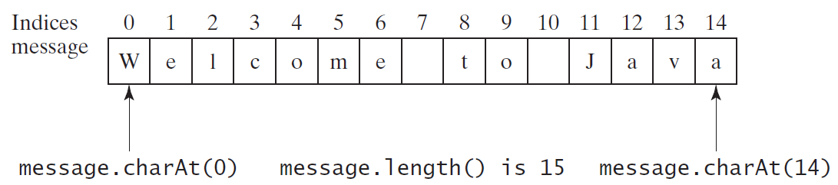
Getting Characters from a String
String message = "Welcome to Java";
System.out.println("The first character in message is "
+ message.charAt(0));

Slide 50
Converting Strings
"Welcome".toLowerCase() returns a new string, welcome.
"Welcome".toUpperCase() returns a new string, WELCOME.
" Welcome ".trim() returns a new string, Welcome. The trim method removes spaces at beginning and end of string.

Slide 51
String Concatenation
String s3 = s1.concat(s2); or String s3 = s1 + s2;
// Three strings are concatenated
String message = "Welcome " + "to " + "Java";
// String Chapter is concatenated with number 2
String s = "Chapter" + 2; // s becomes Chapter2
// String Supplement is concatenated with character B
String s1 = "Supplement" + 'B'; // s1 becomes SupplementB

Slide 52
Reading a String from the Console
Scanner input = new Scanner(System.in);
System.out.print("Enter three words separated by spaces: ");
String s1 = input.next();
String s2 = input.next();
String s3 = input.next();
System.out.println("s1 is " + s1);
System.out.println("s2 is " + s2);
System.out.println("s3 is " + s3);

Slide 53
Reading a Character from the Console
Scanner input = new Scanner(System.in);
System.out.print("Enter a character: ");
String s = input.nextLine();
char ch = s.charAt(0);
System.out.println("The character entered is " + ch);

Slide 54
Comparing Strings
Example Program: TwoCities.java in D2L

Slide 55
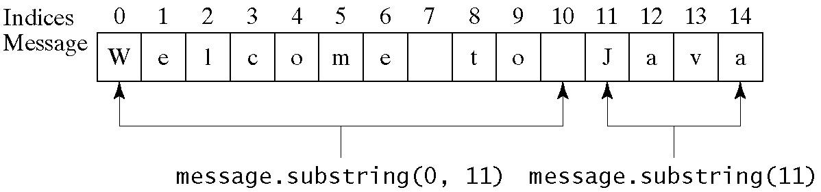
Obtaining Substrings

Slide 56
Finding a Character or a Substring in a String

Slide 57
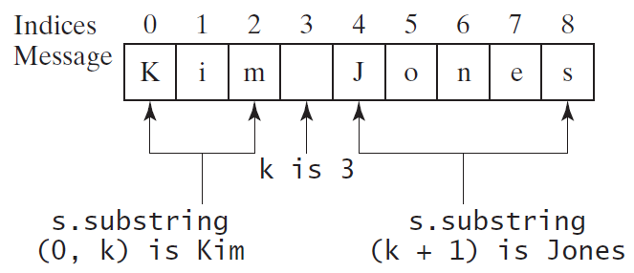
Finding a Character or a Substring in a String
int k = s.indexOf(' ');
String firstName = s.substring(0, k);
String lastName = s.substring(k + 1);

Slide 58
Conversion between Strings and Numbers
int intValue = Integer.parseInt(intString);
double doubleValue = Double.parseDouble(doubleString);
String s = number + "";

Slide 59
Formatting
Use the printf statement.
System.out.printf(format, items);
Where format is a string that may consist of substrings and format specifiers. A format specifier specifies how an item should be displayed. An item may be a numeric value, character, boolean value, or a string. Each specifier begins with a percent sign.

Slide 60
Frequently-Used Specifiers
Specifier Output Example
%b a boolean value true or false
%c a character 'a'
%d a decimal integer 200
%f a floating-point number 45.460000
%e a number in standard scientific notation 4.556000e+01
%s a string "Java is cool"

